Slide 1
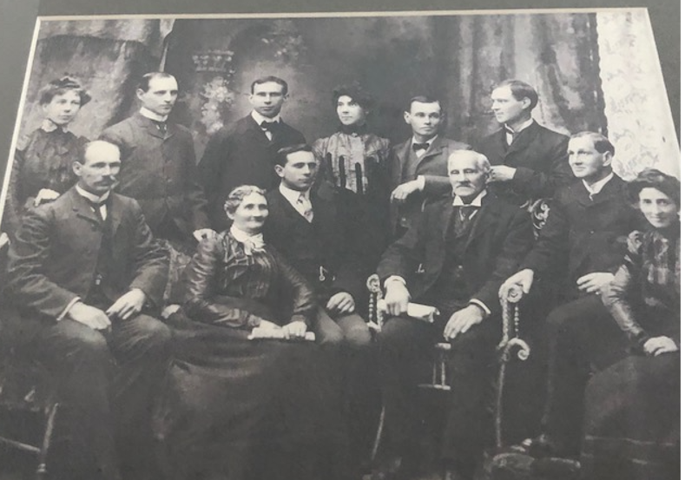
The Eesleys Family - Standing left to right – Jennie, George, Charles, Bessie, John, Robert Albert (“Bert”). Seated left to right – Will, Jeanie Goldie Eesley (Mom), Garfield, Albert Robert Eesley (Dad) , Alf (Albert Robert), Hanna (“Anna”). Photo taken circa 1900

Slide 2
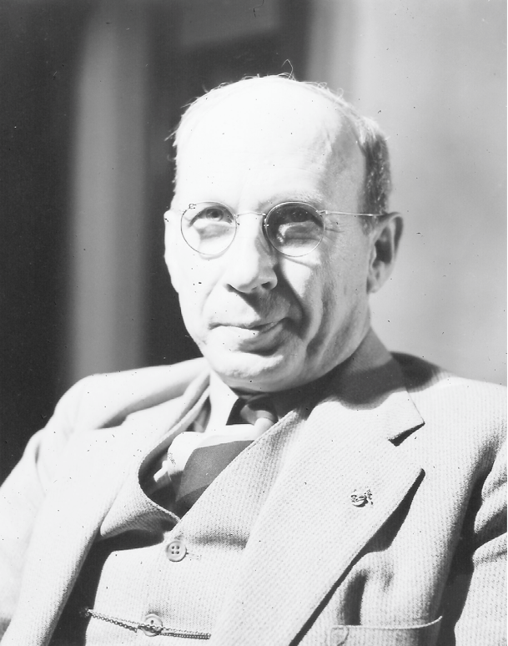
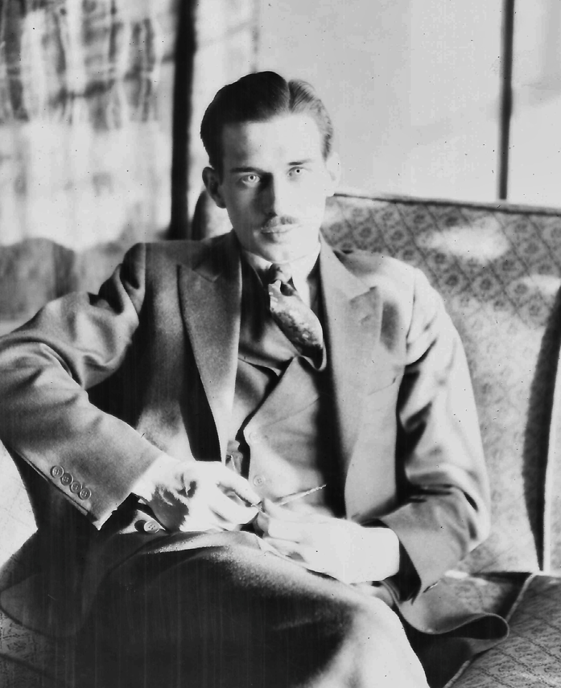
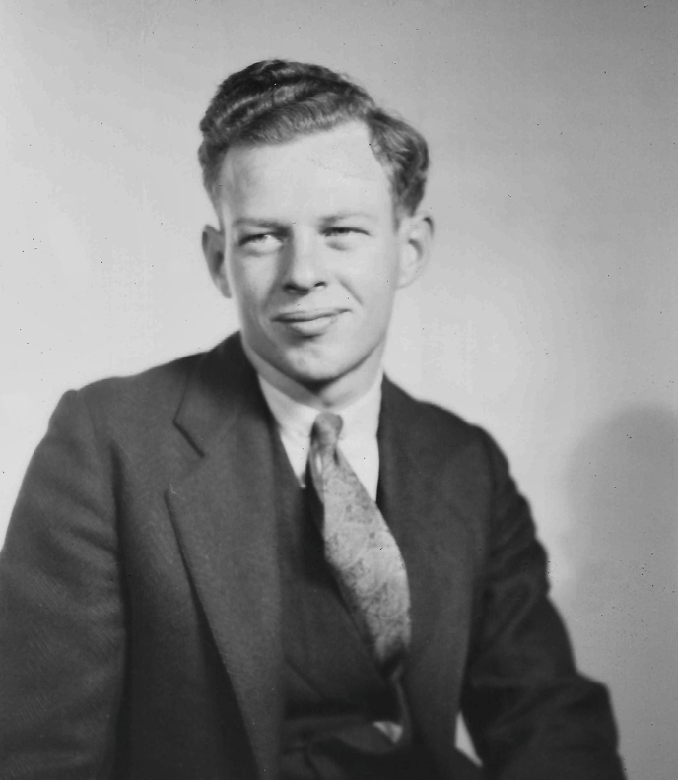
Charles Leonard Eesley
Born 9/26/1879
Died 10/1972
Photo taken circa 1928
Married Lilly Dale Chenoweth
Leonard David Eesley
Born 11/19/1904
Died 1/8/1976
Photo taken circa 1929
Married Helen Bernandine Alspach
Donald Stuart Eesley
Born 9/24/1908
Died 5/15/1975
Photo taken circa 1932
Married Margaret Adeline Youman
Note: Siblings Dale, Will, Mary, Lyle, Jean and Helen not pictured.

